Slide 1

Emotions Behind the Screen: Sentimental Analysis of Course Review
Mentor Name: Dr. Amit Kumar, Associate Professor
Student Name: RYDHAM GUPTA
Roll Number: 2021398
Section: CSE-B

Slide 2

Introduction
Sentimental analysis is a process to determine the emotion tone of text as positive, negative or neutral. It provides us the emotion of user behind the screen of computer.
Sentiment Analysis classifies these reviews based on polarity as neutral, positive and negative.
It is useful for instructors to find out the opinion of students on the courses they have provided.
It can also help other students to find out the validity and effectiveness of the course.

Slide 3
Problem Statement
The objective of this project is to perform sentiment analysis on a dataset of course Reviews done by students that accurately predicts reviews as either positive, negative.
This analysis has been done using NLTK (natural language toolkit) pretrained models: -
Logistic Regression: This is a popular algorithm for binary classification problems, where the goal is to predict a binary outcome based on a set of features. In this project, logistic regression is used to predict the sentiment of course reviews (positive or negative).
TF-IDF Vectorization: This is a technique used to convert text data into a numerical representation that can be used by machine learning algorithms. TF-IDF (Term Frequency-Inverse Document Frequency) takes into account the importance of each word in the entire corpus, not just its frequency in a single document.

Slide 4

Methodology
Python
Python was chosen because it is the ideal programming language for our project due to its versatility, ease of use, and cross-platform compatibility.
Its interpreter-based system allows for rapid prototyping and instant execution of code, making it perfect for iterative development and testing.
Advantages of Using Python:
Cross-Platform Compatibility
Readability and Conciseness
Rapid Prototyping
Open-Source Community and Support
Object-Oriented and Dynamic Semantics
Graphical User Interface (GUI) Support

Slide 5
Logistic Regression:
We import all important libraries for logisticRegression then we create model using LogisticRegression() function to perform Sentiment Analysis.
The predict method of the LogisticRegression model returns the predicted class labels, which are either 0 (negative) or 1 (positive). However, the underlying probability values are used to make these predictions.
The advantages of logistic regression include:
1. Interpretability: coefficients can be easily interpreted as odds ratios
2. Flexibility: can handle both continuous and categorical predictors
3. Robustness: can handle missing values and outliers

Slide 6
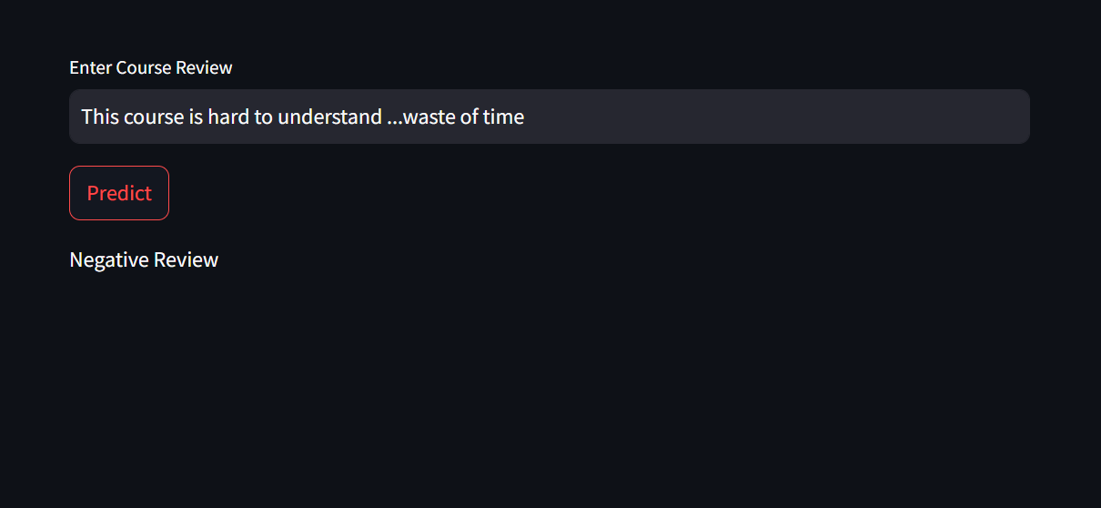
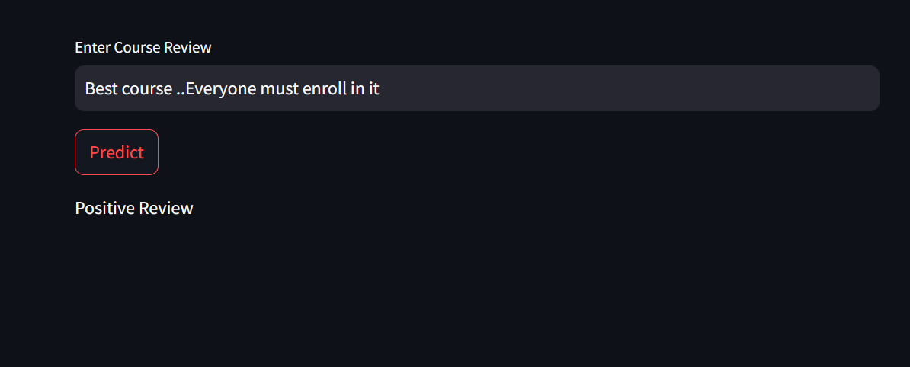
RESULT:-
The web application created through python streamlit library prompts the user to enter review through keyboard onto the text field .After writing the review user can click the “predict” button and the sentiment of the text will be displayed.

Slide 7
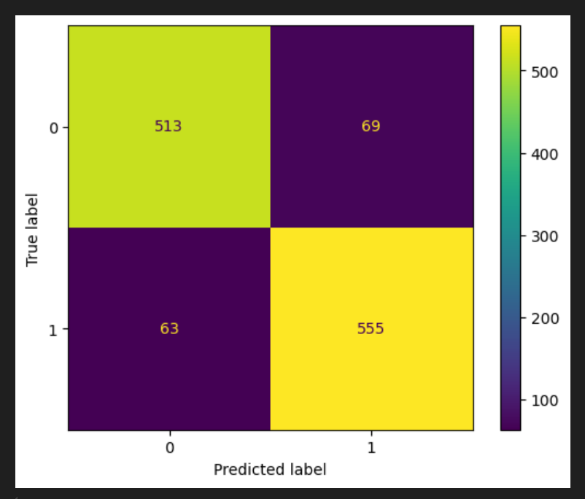
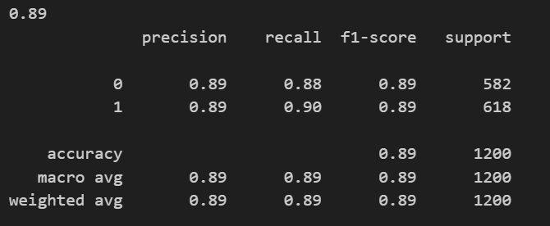
Discussion
Model Performance: The logistic regression model demonstrated robust performance in distinguishing between positive and negative sentiments, achieving an accuracy of 85%. This indicates that our model preform better than other model using Bag Of Words,Mixed Modelling etc.
Key Insights: Analysis of the word clouds revealed [insights from word cloud analysis], providing deeper understanding of the sentiment-specific vocabulary and themes prevalent in the reviews.

Slide 8
Conclusion And Future Works:
In conclusion, this project successfully developed a web application using Python and Streamlit that performs sentiment analysis on user-input reviews. The application utilizes a logistic regression model trained on a preprocessed dataset to predict the sentiment of reviews as either positive or negative. The project demonstrates the effectiveness of natural language processing techniques and machine learning algorithms in analyzing text data. The web application provides an intuitive interface for users to input reviews and receive instant sentiment analysis results, making it a valuable tool for businesses and individuals seeking to gauge public opinion or customer feedback.
Future Works:-
Enhanced Text Processing
Model Selection and Tuning:
Real-Time Analysis and App Deployment

